Slide 1

Work Plan & Calendar
For Full Development
OsaTennis360.com Consulting
“Tennis business made better”
(818) 914 - 8403 ~ ramon@ramonosatennis.com

Slide 2
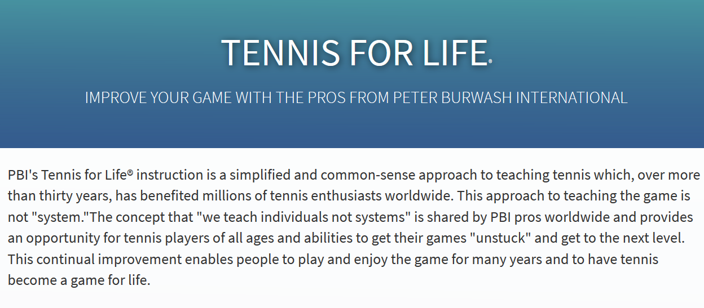
Proven Approach to Tennis Instruction
https://www.pbitennis.com/instruction

Slide 3

What are your immediate project goals?
Peter Burwash International is looking for a membership website ​​that PBI Pros can sell instructional and related customer-oriented multimedia content through. PBI would also like to learn about how to train their PBI Pros to upsell complementary valued-added services through said membership website.

Slide 4
Month 1: Increased sales from membership portal and Osa360 marketing trainings and campaign
Weeks 1-2 | Teach your Dallas staff and pros intent based branding; 10 virtual “Intent Based Branding Methodology” trainings (20 total hours of training) video integration on to website. 2 hour video shoot with clips uploaded onto website. portfolio of stock videos. video integration on to website 2 hour video Design, develop, and manage a business model for your PBI Pros in order to increase the percentage of PBI Pros who participate in this project from 11% to 55%
Weeks 2-4 | Design, Develop, a Membership Site and integrate 20 YouTube videos and related content throughout your site b) Run an automated email marketing campaign with free content to your members- we will help you construct those c) Run paid advertisements to your site and to your offers d) Successful implementation of any other tasks set by PBI

Slide 5

You asked, we answered
You asked us to include in our proposal, the following:
What’s involved from a financial perspective? See Excel doc
What’s involved from a logistical perspective? See this document
What PBI will need their Pros to do? See Calendar in this document
How are we going to produce videos? See this document
How do we get existing and new global clients to pay? See this doc
How much should they charge? See Excel doc
How long should it take to see a return on investment? See Excel doc
How much potentially can they make over 1 year, 3 years, 5 years? Excel
Successful implementation of any other tasks set by the PBI

Slide 6
Description of Requirements for Client
Designer shall provide services to Client for a period of twelve months (one year). The monthly payments shall be due on the 1st day of each month, beginning May 1, 2020. The last payment for the one-year contract shall be made on April 1, 2021. However, this contract does not serve to establish any relationship for other internet marketing services such as third-party expenses such as budgets made toward paid ads, and if such an agreement is to exist, it can only be formed at the discretion of the parties at a later date.
The date and manner of such payments shall be as follows:
$2,000 set up fee + $500/mo + 30% gross profits from Osatennis360 Consulting Marketing Efforts

Slide 7
Continued Reading...
Tasks needed to be accomplished each week in order to complete this project on schedule
OsaTennis360 Consulting, LLC
“Tennis business made better”
(818) 914 - 8403 ~ ramon@ramonosatennis.com

Slide 8
Month 1: Increased sales from membership portal and campaign
Week 1 | 10 virtual Intent Based Branding trainings (20 total hours of training) video integration on to website 2 hour video shoot with clips uploaded onto website portfolio of stock videos video integration on to website 2 hour video Design, develop, and manage pbitennis.com Membership Portal to reflect that PBI's Tennis for Life® instruction is a simplified and common-sense approach to teaching tennis which, over more than thirty years, has benefited millions of tennis enthusiasts worldwide. Unlimited dedicated pages Live Social Media Channels integrated into site Strict Set of Targeted Plug-ins (see full list on next slide):

Slide 9
Month 1: Increased sales from membership portal and campaign con’t...
Week 1 con’t... | Tested set of integrated and configured Plug-ins (see full list on next slide): o Yoast Premium SEO o Google Analytics o Facebook Pixel o Trillio for text integration for 1:1 lessons with each PBI Pro who signs-up o Flightview integration for airlines o CRM integration (InfusionSoft, Sugar, Zoho) o Payment gateway integration (Braintree, Authorize.net, Stripe, PayPal) § Yoast Premium SEO § Google AdWords § Hotjar § Twitter Analytics § ClickFunnels § Deadline Funnel · Custom HTML5/CSS3 design for “website special effects” · Additional WordPress Configurations including live chat, live call, video streaming, twitter feed

Slide 10
Month 1: Increased sales from membership portal and campaign con’t...
Weeks 1 & 2 | Analyzation and further optimization of tasks from Week 1 (make adjustments as needed) Teach your Dallas staff and pros intent based branding Training with me personally (10 hours) Time spent reviewing calls (10 hours) Time Scripting Videos (12.5 hours) (15 minutes per video) Time Rehearsing/Shooting Videos (25 hours) Time Editing Videos (25 hours) (on average, 1 hour per video) Time uploading/optimizing videos for youtube (7.5 hours) (roughly 20 minutes per video) Time emailing videos to email list (4 hours) (roughly 10 minutes per video)

Slide 11
Month 1: Increased sales from membership portal and campaign con’t...
Week 3 | Analyzation and further optimization of tasks from Week 2 (make adjustments as needed) Run an automated email marketing campaign with free content to your members- we will help you construct those Launch full-scale search engine optimization, or SEO, campaign: In-depth keyword research Keyword traffic analysis Keyword competition analysis Benchmark current traffic and SERPs (Search Engine Result Pages) Manual search engine submission Manual submission to niche directories Scheduled resubmissions Article submissions Link-building from niche blogs Managing reciprocal links

Slide 12
Month 1: Increased sales from membership portal and campaign con’t...
Week 4 | Analyzation and further optimization of tasks from Week 3 (make adjustments as needed) Launch full-scale monthly social, web, sales report (Measurement & Insights): Google analytics Twitter analytics Facebook analytics Monthly Web, Sales, Social insights and measurement analytics reports Traffic Report (Google + Bing + Yahoo data) merged Keyword position report Backlinks report Search engine submission report Customizable traffic report Customized backlink report Customizable search engine submission report

Slide 13
Month 2: Increased sales from additional recommended services
Week 1 | Design, get approval, develop, and manage all of next month’s social media posts for PBI
Week 2 | (Optional) Scheduled on-site photoshoot & video recording of Peter Burwash International Headquarters and his offerings; post-production editing & development included
Week 3 | Revamp, optimize, & secure https://www.pbitennis.com/ to reflect that PBI's Tennis for Life® instruction is a simplified and common-sense approach to teaching tennis which, over more than thirty years, has benefited millions of tennis enthusiasts worldwide.
Week 4 | Revamp PBI social media profiles and rest of online presence to reflect competitive advantages, result-oriented business model, and proven track record

Slide 14
Portfolio and A-La-Carte Services
See our portfolio and our list of a-la-carte services that you can choose from to transform your business
OsaTennis360 Consulting, LLC
“Tennis business made better”
(818) 914 - 8403 ~ ramon@ramonosatennis.com

Slide 15
SERVICES
OVERVIEW
Responsive Web Design, Development, & Management
Social Media Marketing
Photography, Videography & Post-Production
Google AdWords, Social Media, and other Pay-Per-Click Advertising
Branding & Graphic Design
Cloud Hosting, Backup & IT
Email/ Newsletter Management
E-Commerce Platform Design
Search Engine Optimization (SEO)
Payment Gateway Integration
Content Creation & Copywriting
Print Design & Marketing Material
Competitor/ Market Research & Analysis
Monthly Social, Web, & Sales Reports

Slide 16
SERVICES
OVERVIEW
DRONE FOR VIDEO PRODUCTION
Done footage draws prestige to your site or product with beautiful eye catching drone footage, perfect for location based businesses and real estate.
Production – one location, production gear, permits and insurance
Post production – editing and logo graphics
Virtual Reality
Let your clients be immersed in your world with the latest VR technology bringing your product to life. The sheer intensity of VR creates an experience unlike any other form of media. Create something your clients will remember.
VR video
360 video
360 image

Slide 17
Intent Based Branding Through Specialized Videography Services
Delivering valuable content that builds a powerful personal, professional brand while offering paid services without breaking the bond made with consumer.
Portfolio includes:
Performanceplustennis.com
Fundamental Tennis Youtube Channel:
Osatennis360 Youtube Channel
www.artofwinningtennis.com

Slide 18
RESPONSIVE WEB DESIGN, DEVELOPMENT, & MANAGEMENT
Responsive website design is preferred by search engines as it is highly user friendly, and has the same URL and the same content whether the user visits the website from mobile, desktop or a tablet.
Portfolio includes:
ArtofWinningTennis.com
TennisCoachAcademy.net
SheilaE.com
TennisLoversForCharity.com
SheilaKelley.com

Slide 19
RESPONSIVE WEB DESIGN, DEVELOPMENT, & MANAGEMENT
Check spelling on the following pages:
http://geps.org/visas-and-i-20s/
http://geps.org/placement-services/
http://geps.org/testing-services/
Increase font on the following pages:
http://geps.org/
http://geps.org/summer-camp/

Slide 20
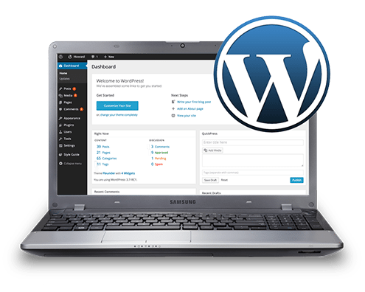
CONTENT MANAGEMENT SYSTEM (CMS) INTEGRATION
CMS such as WordPress allows for:
harnessing the power to create incredible content
updating it when needed
customization and core development that is easy to manage and update
Experience includes:
Kosher Cruises
UncleBudsHemp.com

Slide 21
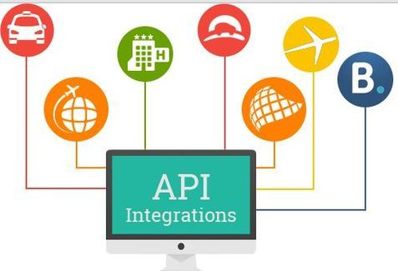
APPLICATION PROGRAM INTERFACE (API) INTEGRATION
API, or client side software-to-software integration allows your webmaster to easily access information from other web applications such as:
Amazon product information
Payment gateway integration (e.g., PayPal, Stripe)
Mailchimp mailing list information
Direct email marketing integrations (e.g., Gmail, GoDaddy email)
Portfolio includes:
FirstBreakAcademy.com
DefendingYouTucson.com
StarsTV.net

Slide 22

E-COMMERCE PLATFORM & PAYMENT GATEWAY INTEGRATION
Allows for selling of your products and/or service online. Also lets your clients book appointments through your website- even if you currently use a third-party application for e-commerce
Past experience includes:
KaiGourmet.com
Sheila E. Merchandise
Hemp Products for Sale

Slide 23

PHOTOGRAPHY, VIDEOGRAPHY, AND POST-PRODUCTION
55% of people watch videos online every day. 500 million people are watching videos on Facebook every day.
Promote your brand or product through the incredible power of digital media
Draw traffic to your product or website, social media and engagement via email
Post production – editing, colour grading of images or footage you already own for use on your website as background or as social media material
Click Here for Past Work!

Slide 24
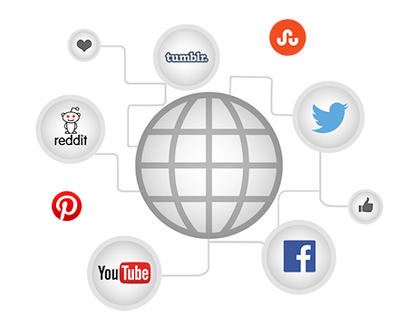
SOCIAL MEDIA MARKETING
Organic and/or Paid Promotion throughout numerous Directories, Message Boards, Social Networking Channels
Connect with key industry influencers to build relationships gain reviews/referrals from their networks
Viral growth with browsers’ use of tools created to enhance their experience and at the same time advertise your website to their online networks
Click Here for Past Work!

Slide 25
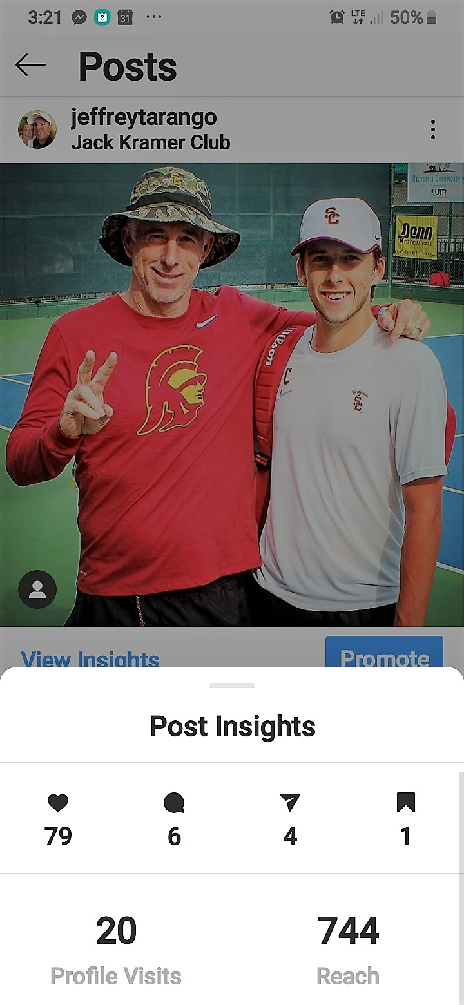
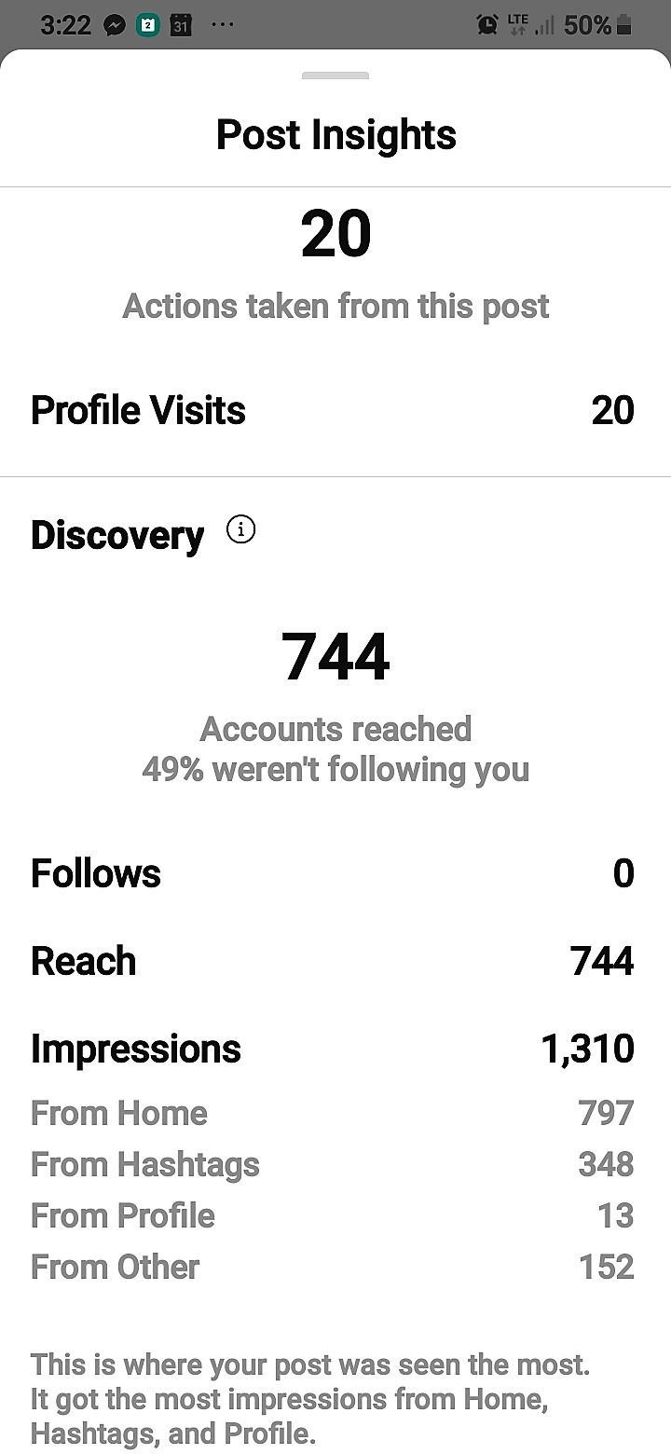

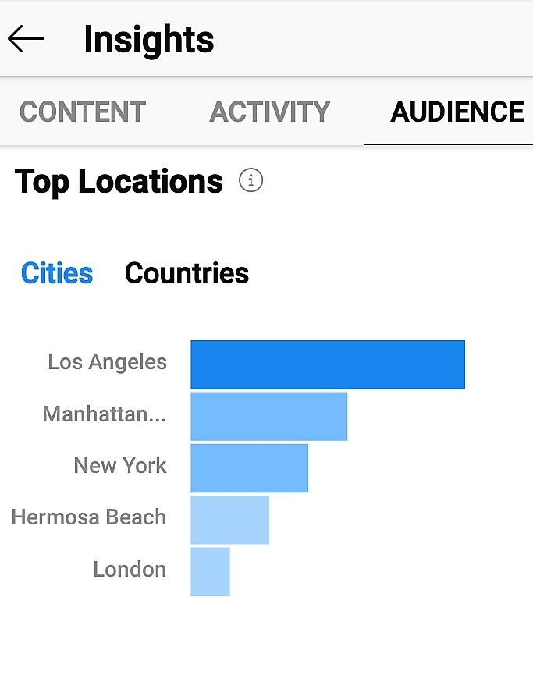


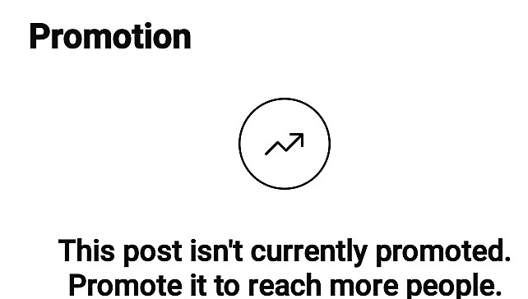

ORGANIC ADVERTISING!

Slide 26
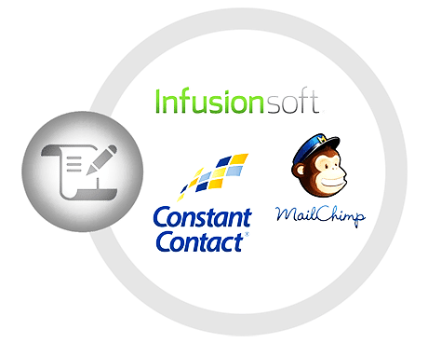
DIRECT EMAIL MARKETING & NEWSLETTER MANAGEMENT
Andras can manage your newsletter for you by working with your content to compile it, style it, and make sure it goes out on time.
Direct Email Marketing to current customers to generate repeat business and outreach to new ones
Collection of your blog content and promotions into monthly newsletter
Mailing list exports from your site
Reports on delivery, opens and clicks
Click Here for Past Work!

Slide 27

PAY-PER-CLICK ADVERTISING (PPC)
Pay Per Click is one of the quickest ways of getting highly potential leads through a website for any business. It is considered as one of the most economical ways of running ads on the internet in order to promote a business aggressively.
Pay Per Click is very promising, as one has to pay only when his or her PPC ad is clicked on. Therefore, it carries the most value in terms of price, provided that the PPC campaign is managed well.
Learn More About PPC Ads Here

Slide 28
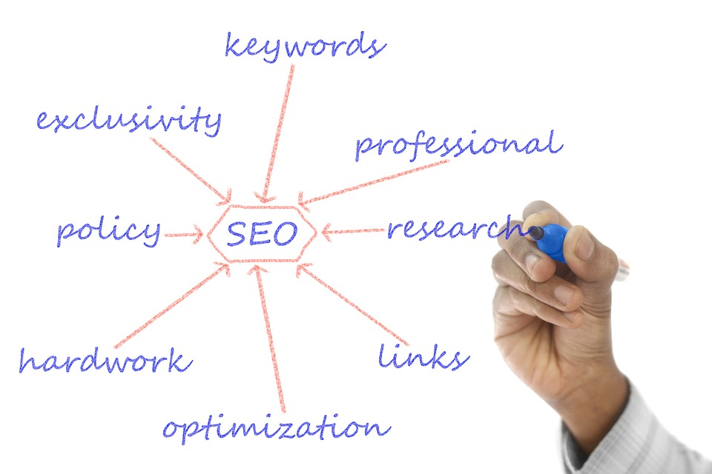
SEARCH ENGINE OPTIMIZATION (SEO): A HOLISTIC APPROACH
A holistic and semantic approach to SEO includes:
Initial SEO Audit
Formulation of SEO Strategy
Strategy Implementation
Results of Strategy Implementation
Revisions
Reporting
Work Sample - Click Here

Slide 29

MONTHLY TRAFFIC & ANALYTICS REPORTS
Each month, you have the option to request a custom traffic & analytics report to show you your return on investment from your web, social, and sales activities.
These reports will come in the form of a PowerPoint presentation and should take no more than 5-15 mins to review. As always, I will be available to address any concerns.
Work Sample - Click Here

Slide 30
THE END
Thank you for your time!
Contact Andras Cruz-Aedo or Ramon Osa at
(310) 218-6803 or
email andrascruzaedo@email.arizona.edu
today!

